Slide 1

Introduction to Myntra
Indian fashion e-commerce company
headquartered in Bengaluru, Karnataka, India. founded in 2007 -2008 by Mukesh Bansal , Ashutosh Lawania and Vineet Saxena
In 2014, Myntra was acquired by Flipkart in a deal valued at ₹2,000 crore The purchase was influenced by two large common shareholders Tiger Global and Accel Partners
Busness Model
Ecommerce platform: offers 1,50,000 products of over 1,000 brands
operated on the B2B (business-to-business) model

Slide 2
Markect Position
competes with gaints like Ammozan, Purplle,Meesho Tatacliq
holds signifiant role in E-commerces industry
Grouing and Tie-Ups
In 2014, Myntra was acquired by Flipkart in a deal valued at ₹2,000 crore
tie-up with Nike through the dealer Funfash to sell all authentic Nike accessories-2016

Slide 3
Myntra Analysis

Slide 4
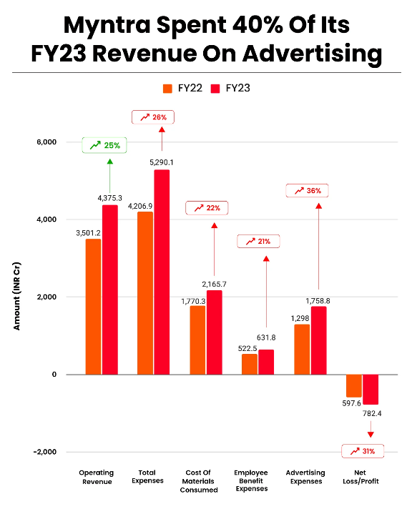
Myndra Total Revenue and Expenditure 2023-2024
Myntra’s operating revenue jumped 25% to INR 4,375.3 Cr in 2023 from INR 3,501.2 Cr
Total expenditure rose to INR 5,290.1 Cr in FY23, an increase of 26% from INR 4,206.9 Cr in 2022
At INR 1,758.8 Cr, the Flipkart-owned company spent almost 40% of its revenue from operations on advertising in 2023

Slide 5
Myntra SWOT Analysis
Strength
End of Reason Sale (EORS): One of the most prominent sale events on Myntra
Technology & User Experience: Myntra has invested heavily in technology to enhance the user experience
Supply Chain and Logistics: Myntra’s supply chain and logistics infrastructure is robust, allowing for quick deliveries nationwide
Data Analytics: Myntra uses data analytics to understand customer preferences, buying patterns, and trends
Mobile App:
On 10 May 2015, Myntra announced that it would shut down its website, and serve customers exclusively through its mobile app beginning 15 May

Slide 6
weakness
Dependence on Discounts
Operational Challenges: E-commerce operations can face logistical challenges
High Return Rates
Intense Competition
Inherent Challenges with In-house Brands
Over-reliance on the Indian Market
Opportunities
Expansion into Tier 2 and Tier 3 Cities
Diversifying Product Offerings
Enhancing Tech Capabilities With advancements in AR (Augmented Reality), VR (Virtual Reality), and AI (Artificial Intelligence)
Collaborations and Partnerships partnering with more celebrities, influencers, and designers
Enhancing Customer Loyalty Programs

Slide 7
Threats
Intense Competition
Amazon, Ajio, and others vie for the same customer base, and new entrants can increase competition further
Regulatory Challenges
Digital Security Threats
Brand Reputation Risks

Slide 8
Customers reviews
High Impact
Apprecisation of on Time delivery
Service apprecisation ( refound and return)
Prouduct Quality

Slide 9
low impact
customers services
Product changes
delivery services
Offers reciving issues

Slide 10
strategic Recommentation
Customers Engaments
marketing stratge
Offer issues
refounds and returns
digital marketing

